Slide 1

ICN-IP Coexistence Solutions
MHD Nazeer Kawas , Lisa Facciolo

Slide 2
Replacement of the existing architecture Internet Protocol (IP): - challenging task involve multiple parties coordination such ISPs.. -indefinite time to update the hardware and software, unexpected complications. -Coexistence between old and new architecture which is the purpose of our presentation.
The current Internet architecture:
- was designed for small research community 3 decades ago.
- now more than 23 billion devices , this misalignment in usage led to explore new solutions
- first issue is the availability of unique IP, another one is the type of traffic (HTTP),now 86% only video
traffic
From security aspect this design doesn’t guarantee origin auth, data integrity , data confidentiality

Slide 3
What is ICN? - new network communication module which might replace the current one (host-centric to information-centric networking). the ICN paradigm was first introduced in the TRIAD project in 2001. - instead of using IPs and DNS , they can send request only specifying only content names. - This decoupling between request sending and content transferring introduces several benefits: reduction of latency and network load due to in-network caching, inherent content integrity and better support for mobility due to name-based routing. - ICN is suitable networking model for emerging technologies, such as (IoT) and 5G. (in-network caching feature)

Slide 4
Why ICN? - 5G-ICN provides a single protocol able to handle mobility and security, instead of using a diverse set of IP-based Third Generation Partnership Project (3GPP) - Additionally, the receiver-driven communication in ICN allows IoT-receivers to ask for data without revealing their location information, thus being privacy supporting. - it provides a unifying platform with the same layer-3 Application Programming Interfaces (APIs) to integrate heterogeneous radios and wired interfaces in the same network - it converges services like computing, storage, and networking over a single platform

Slide 5
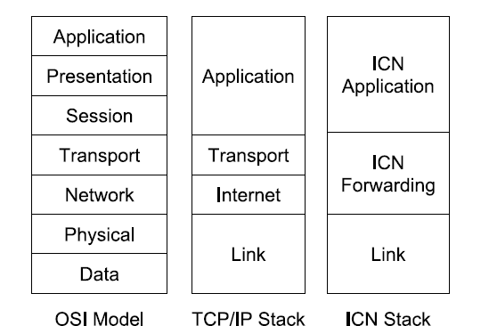
Comparison Between IP-Based and ICN-Based Internet Architectures - ICN Application: the protocols of this layer address content names instead of hosts locations. - ICN Forwarding: equivalent to the TCP/IP Network layer but source and destination IP addresses are removed from the network packets and only the addressed content name is declared. - Link: this layer introduces a mapping between MAC addresses and content names.
Routing: the packets sent by a requester contain only the full name of the content and no IP addresses
NDN and CCN architectures : longest-prefix match
- DONA: name-based routing
- PURSUIT: flat name scheme

Slide 6
- Comparison Between IP-Based and ICN-Based Internet Architectures - Name Resolution: differs according to the forwarding approach in case of name-based routing, the requester specifies a content by providing its full name // which is the same name PURSUIT or NetInf, there is always a dedicated node in the network, which is responsible for the mapping between publishers and subscribers - Storing: in ICN, caching is fundamental and almost any node is able to cache contents and to serve the corresponding requests. - Traffic Management: the congestion control refers to the prevention of the routers from becoming overflowed and it’s provided by ACK messages in TCP/IP. In ICN some architectures, such as DONA, still rely on the existing transport protocols. other ICN solutions NDN, do not provide the Transport layer functionalities and, instead, delegate them to the application itself.

